Slide 1
DATA ANALYSIS & INSIGHTS
Flight Price Analysis
EDA & Feature Engineering Using Python
Obulesu Polisetti

Slide 2

  FLIGHT PRICE ANALYSIS
Presentation Roadmap
1
Project Overview
2
Dataset & Data Quality
3
Exploratory Data Analysis
4
Feature Engineering
5
Univariate & Multivariate Analysis
6
Interactive Dashboard
7
Insights & Conclusion

Slide 3
  FLIGHT PRICE ANALYSIS
Project Overview & Workflow
Project Objective Analyze flight prices and identify how different factors affect ticket prices, such as:
Airline
Source
Destination
Number of stops
Journey date
Departure time
Arrival time
Duration
Total stops
Additional information
Price
Raw Data
Cleaning
EDA
Feature Engineering
Insights

Slide 4
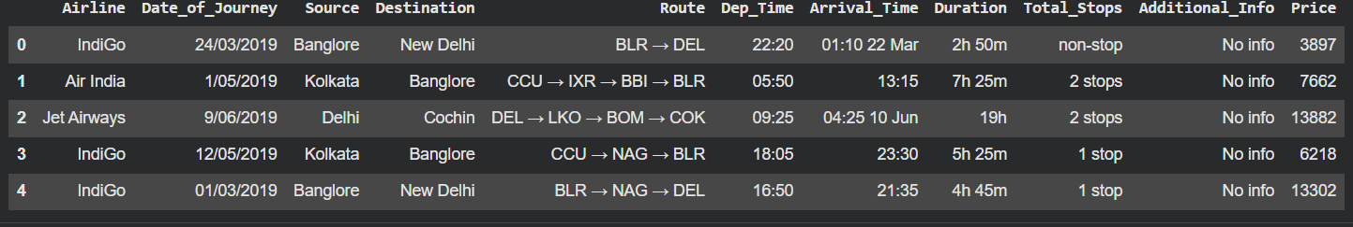
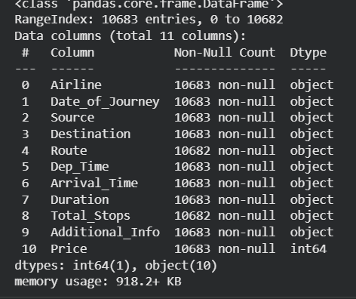
  FLIGHT PRICE ANALYSIS
Dataset Overview
Rows
10.68 K
Columns
11
Target
Price

Slide 5
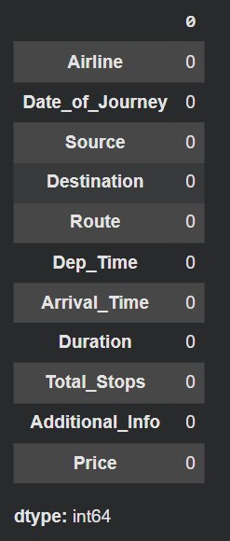
  FLIGHT PRICE ANALYSIS
Data Quality & Cleaning
Missing Values
0
Duplicate Rows
238
Final Rows
10,445
Data Cleaning
Data Types reviewed
Missing values assessed
Duplicate records assessed
Categorical values checked

Slide 6
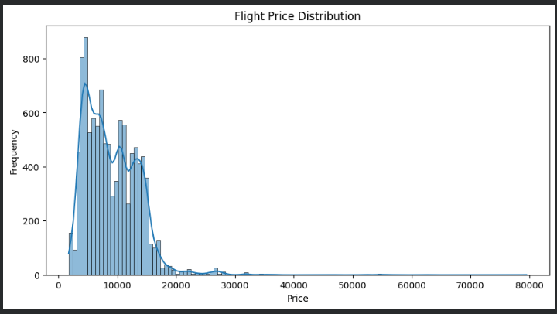
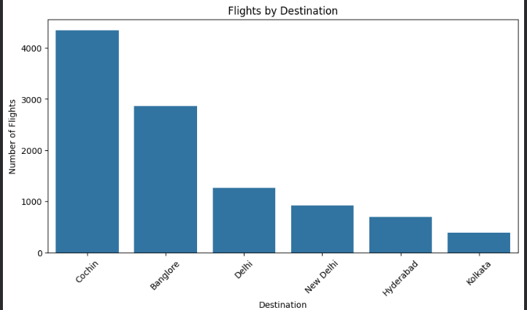
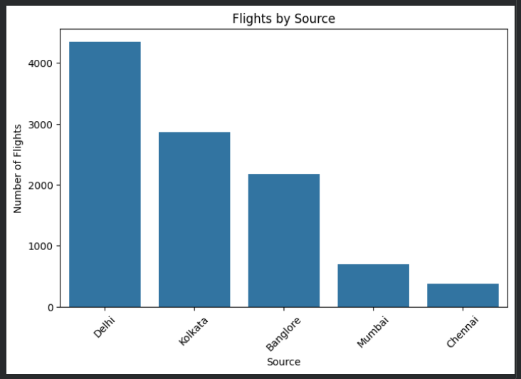
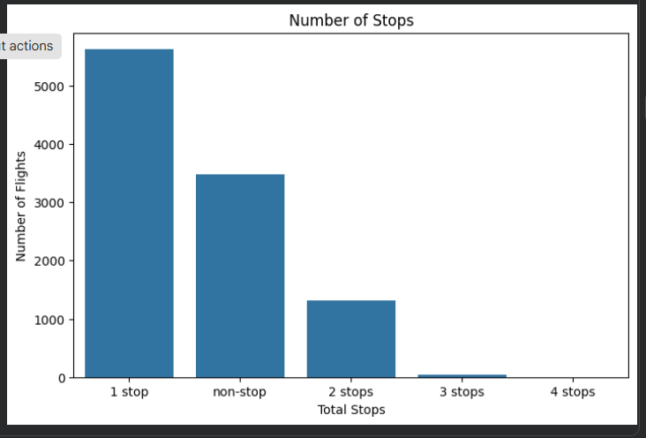
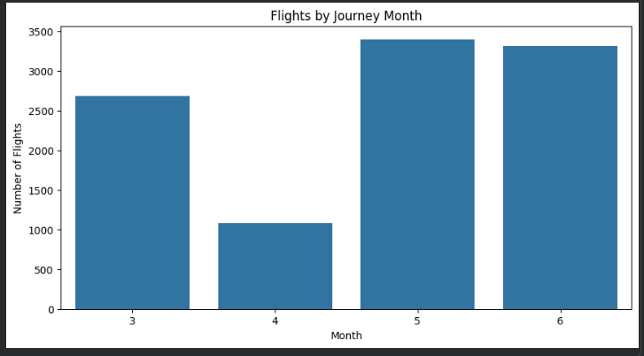
  FLIGHT PRICE ANALYSIS
Exploratory Data Analysis

Slide 7
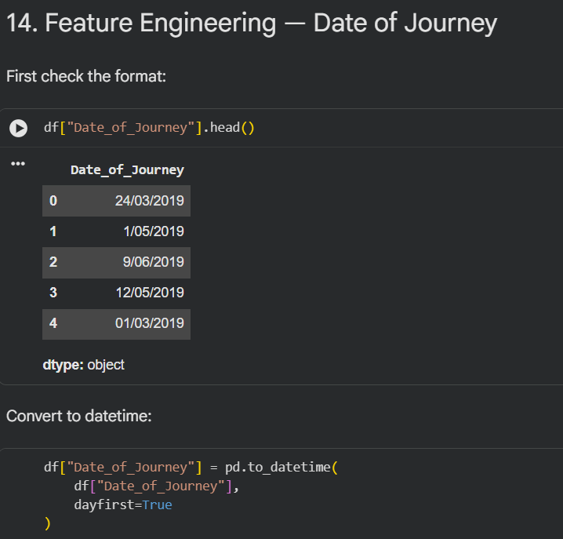
  FLIGHT PRICE ANALYSIS
Feature Engineering
Journey Date
Day > Month > Year
Departure Time
Hour > Minute
Arrival Time
Hour > Minute
Duration
Converted to minutes
Total Stops
Standardized numeric feature

Slide 8
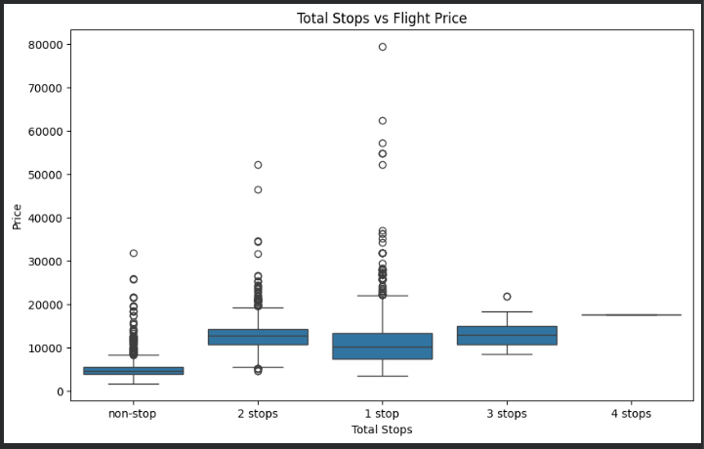
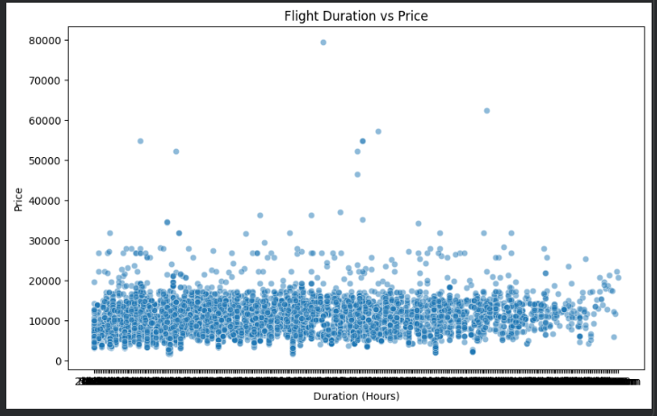
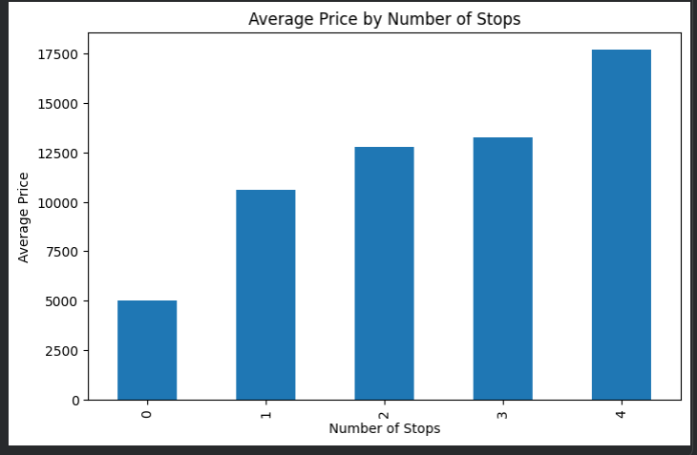
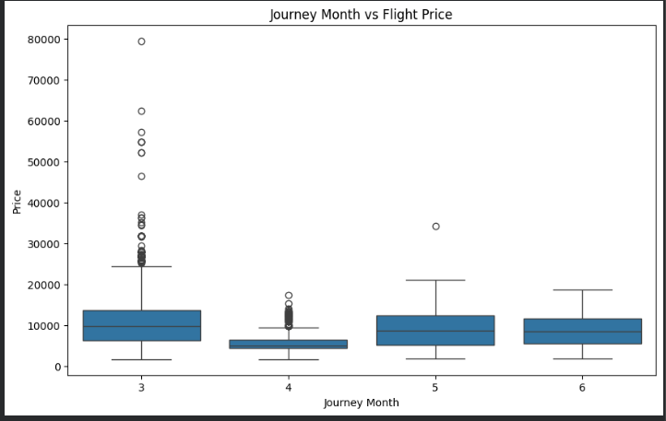
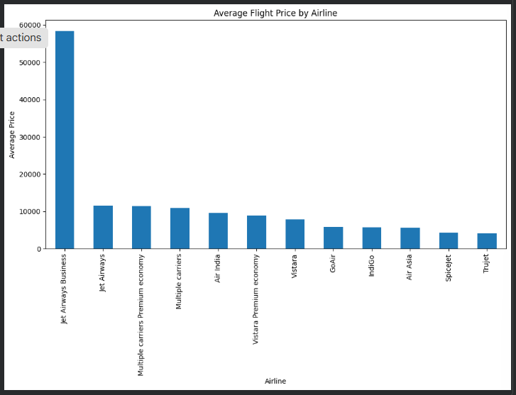
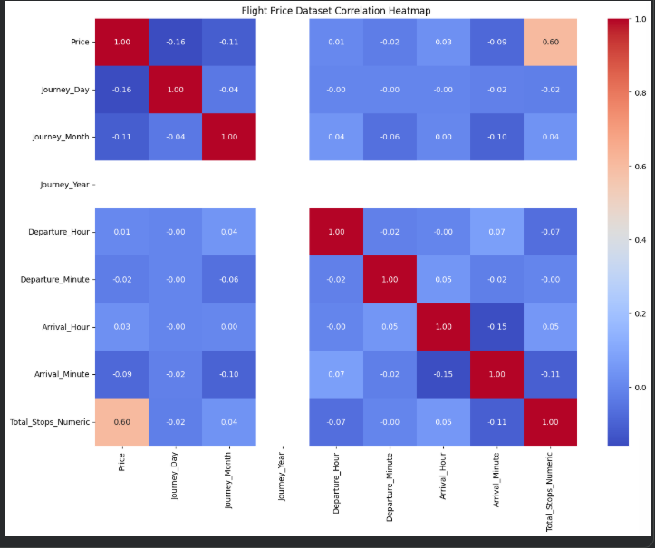
  FLIGHT PRICE ANALYSIS
Bivariate & Multivariate Analysis

Slide 9
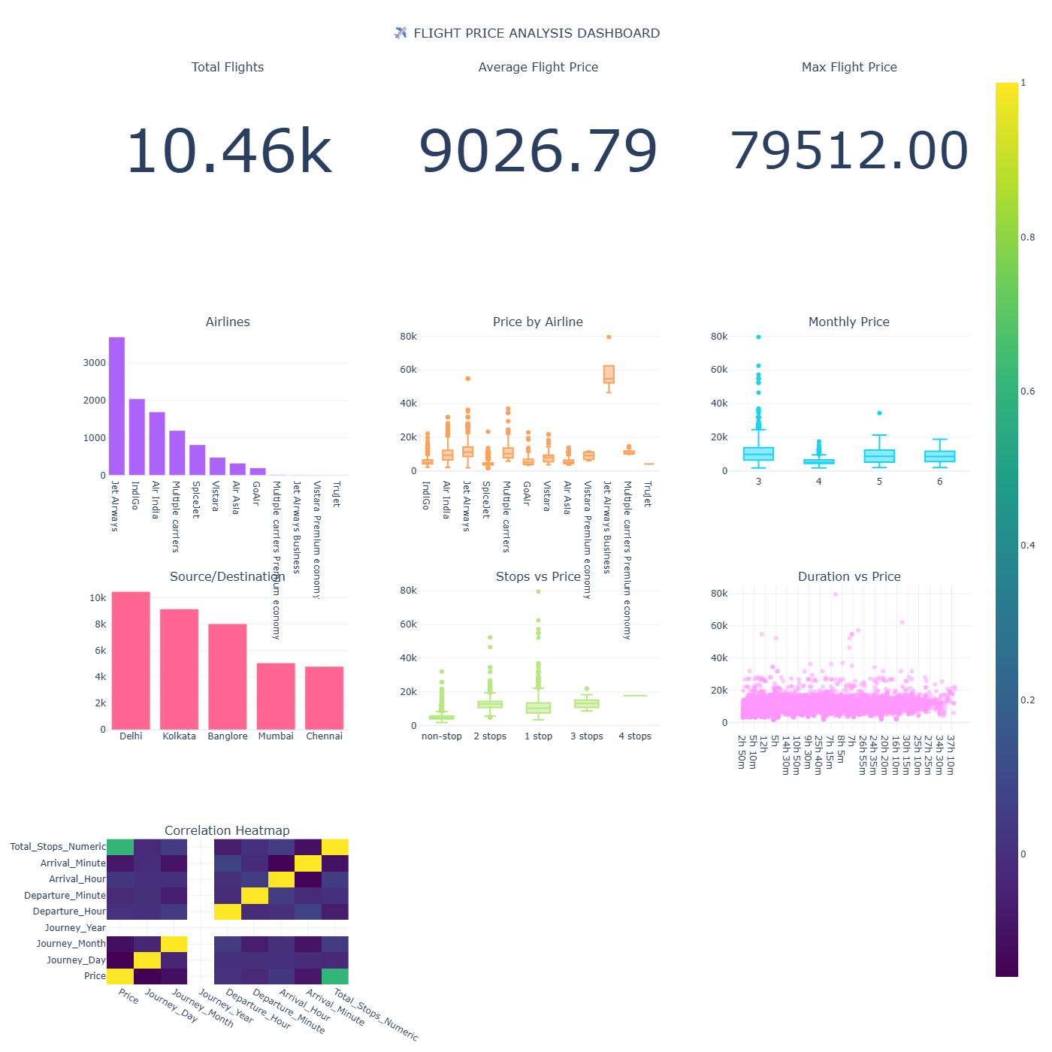
  FLIGHT PRICE ANALYSIS
Interactive Dashboard
The interactive Python dashboard provides a clear visual analysis of flight prices and travel patterns. It presents key metrics such as total flights, average price. Charts are used to Analyze airline-wise pricing, source and destination routes, total stops, journey months, and flight duration. Interactive filters help users explore the dataset and identify important pricing patterns.
Key Dashboard Visuals:
Total Flights
Average Flight Price
Maximum Flight Price
Number of Airlines
Average Price by Airline
Price vs. Total Stops
Month-wise Average Price
Duration vs. Price
Source & Destination Analysis

Slide 10
  FLIGHT PRICE ANALYSIS
Key Insights & EDA Summary
1
Total Records : 10,462
2
Total Features : 20
3
Missing Values : 0
4
Average Flight Price : 9026.79
5
Minimum Flight Price : 1759
6
Maximum Flight Price: 79,512

Slide 11
  FLIGHT PRICE ANALYSIS
Conclusion & Future Scope
The Flight Price Analysis project successfully explored flight pricing patterns using Python-based EDA and feature engineering. The analysis examined airline, journey date, source, destination, stops, duration, and other factors affecting flight prices. Feature engineering transformed raw date and time information into useful analytical features, while visualizations helped identify important relationships and trends in the dataset.
Future Scope
Flight Price Predicted
Model comparison
Feature importance
Interactive Deployment

Slide 12
THANK YOU
Flight Price Analysis & EDA Feature Engineering
Obulesu Polisetti

